Slide 1

Writing Elegant Tests
Notes:
Hello everyone and welcome to today’s webinar: ‘Writing Elegant Tests'

Slide 2

Franklin Webber
Training and Technical Content Lead
twitter.com/franklinwebber
github.com/burtlo
linkedin.com/in/fwebber
Ceci n'est pas un entraîneur
Notes:
My name is Franklin Webber. I'm a training lead here at Chef and I’m honored that you chose to be a part of this session today.

Slide 3



Who I Think You Are
Chef Cookbook Author
Author and maintain Chef Cookbooks with ChefSpec Tests
Maintainer of a test suite that contains lots of duplication
Interested in furthering your knowledge of Ruby's RSpec
OR
Training
training.chef.io
Chef Essentials
Test-Driven Cookbook Development
chef.io/webinars/?commid=191263
chef.io/webinars/?commid=194483
Notes:
When creating this presentation I spent a lot of time thinking about who you are to help guide me in preparing the best content to assist you and to define the scope of what to share with you.
First and foremost I made the assumption that you are an author or co-author of cookbooks. By that I mean you have edited or created recipes and defined attributes. During your time working with Chef you have written unit tests to help describe the intended purpose of your recipes. Ideally I am talking to some of you that have created a bit of a problem for yourself with how big your test suite has become. And whether or not you have that problem you are interested in learning more about how Ruby's RSpec can increase the elegance of the tests you write.

Slide 4
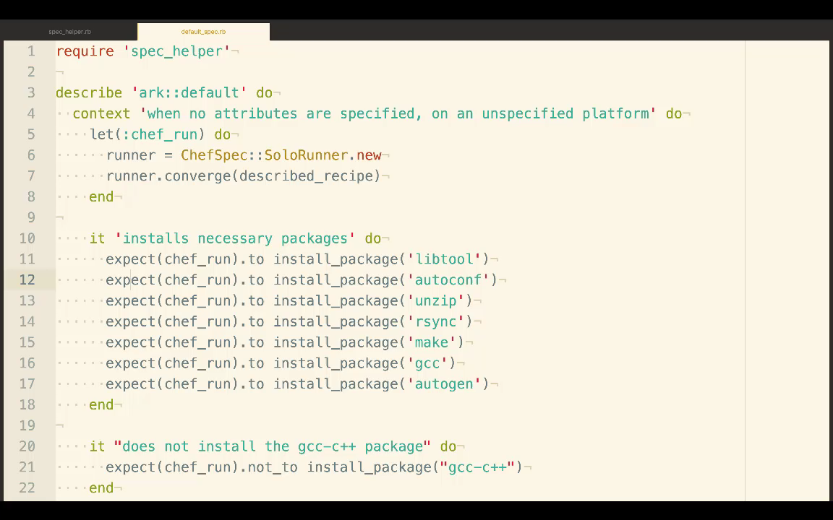
What You Will Learn
The Focus
Reduce duplication in our expectations, examples, and scenario setup
Create re-useable test helpers
Extract these testing resources into a Ruby gem
Notes:
During this session we will identify and tackle repetition present within an example cookbook that addresses the needs across multiple platforms. This cookbook installs multiple packages, sets multiple attributes, and is supported across multiple platforms and platform families.

Slide 5
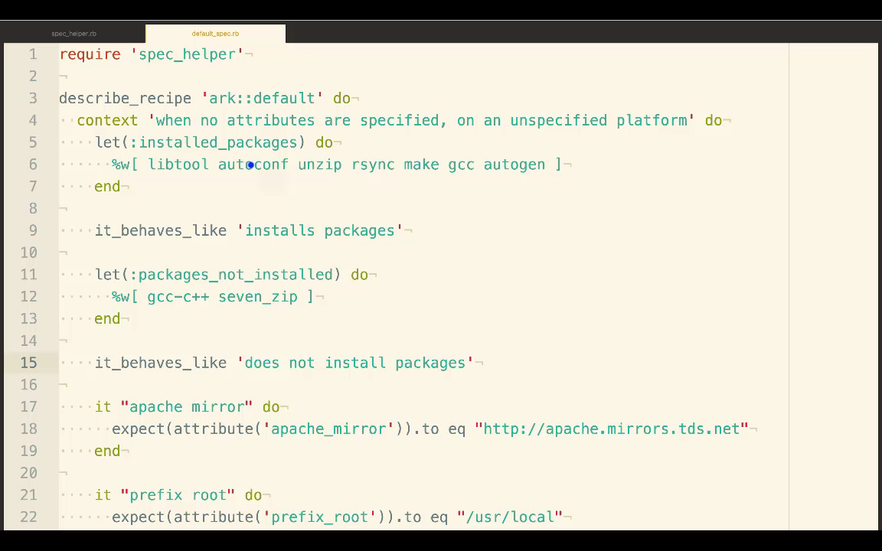
What You Will Learn
The Focus
Reduce duplication in our expectations, examples, and scenario setup
Create re-useable test helpers
Extract these testing resources into a Ruby gem
Notes:
The result would be a resulting test that looks like the following. Reducing the platform setup, expressing more clearly the packages that are installed, and making it easier to express that the attributes are set.

Slide 6
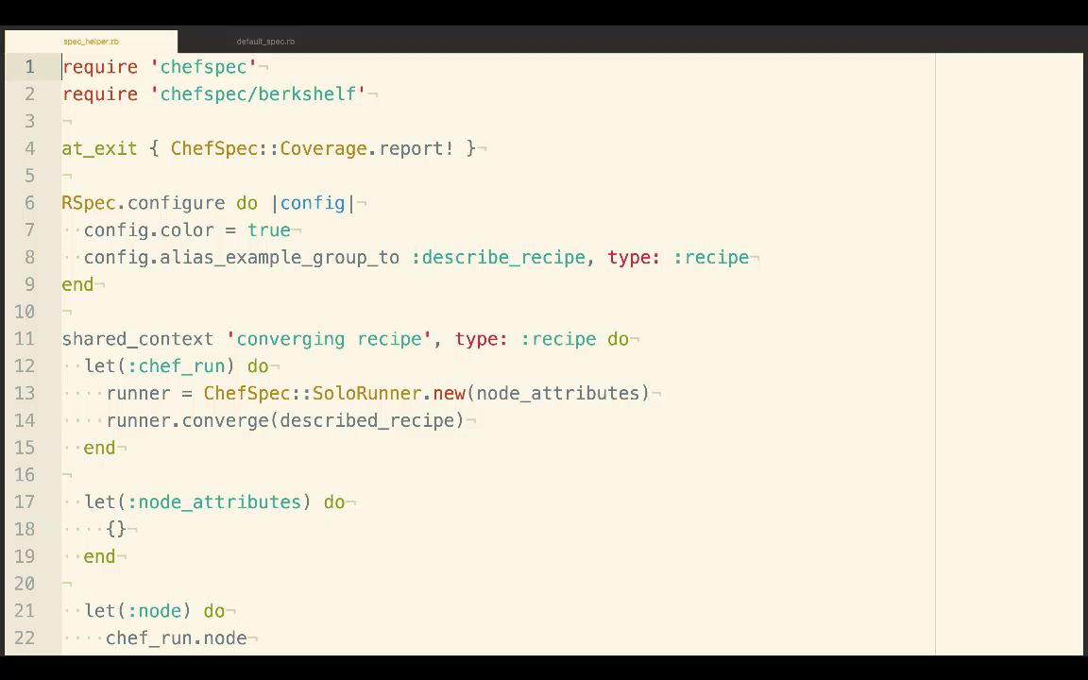
What You Will Learn
The Focus
Reduce duplication in our expectations, examples, and scenario setup
Create re-useable test helpers
Extract these testing resources into a Ruby gem
Notes:
And at the end we'll take all these helpers that we move to a common file within the cookbook and bring it into a re-usable library that we can share with all the cookbooks that we write.

Slide 7
Schedule
Introduction (5 minutes)
techniques (40 minutes)
Introduce 7 concepts with demonstration, and review
questions (12 minutes)
wrap up (3 minutes)
Notes:
This is the schedule of events of today. We'll finish up with these housekeeping items and then we'll move into our series of concepts, then stop for questions, and finally wrap up the work that we have done and where you can go to learn more.

Slide 8
Example Code Repository
> git clone https://github.com/chef-training/elegant_tests-repo.git
Cloning into 'elegant_tests-repo'...
remote: Counting objects: 67, done.
remote: Compressing objects: 100% (41/41), done.
remote: Total 67 (delta 12), reused 67 (delta 12), pack-reused 0
Unpacking objects: 100% (67/67), done.
Notes:
If you want to play along with me and work on the same cookbook that I am using as an example you can clone the code from the chef-training GitHub organization.

Slide 9

Let Us Know What You Think
"Ask a Question" and I will answer it.
"Rate this" presentation to leave your feedback and help me do my work better.
To share, click on the appropriate professional/social network in "Details"
Notes:
We’d love to hear from you during today’s presentation. I’ll be answering questions at the end of the session, so please feel free to send those along using the ‘Ask a Question’ tab on the top of your screen.
If you want to leave a comment and tell me how I did and how we are doing here at Chef please leave a rating and tells us what you liked, what you didn't like, and what you would like to see more of during these sessions.
And last, I'd like to encourage you to share today’s webinar with your professional and social networks.

Slide 10
Writing Elegant Tests
Notes:
For those of you just joining, welcome to today’s session, ‘Writing Elegant Tests,’ I'm Franklin Webber. Let’s get started...

Slide 11
Agenda
let
shared_examples
def method
shared_context
require
alias_example_group_to
creating a Ruby gem
questions
wrap up
TECHNIQUES
Notes:
During today's session I am going to show you how to employ the following techniques during our time today. Within each technique I'll introduce the concepts behind each technique, give a live demonstration of how it used, and then finally review what I did.
We'll be returning to this agenda as we complete each technique so let's get started.

Slide 12
let
"Since we cannot change reality, let us change the eyes which see reality."
~ Nikos Kazantzakis
Concepts
Demonstration
Review

Slide 13
let
Use let to define a memoized helper method.
The value will be cached across multiple calls in the same example but not across examples. It is also lazy-evaluated: it is not evaluated until the first time the method it defines is invoked. See let! if you want to force the invocation before each example.
https://goo.gl/BJp0IQ

Slide 14
Diagramming the let Helper Method
describe 'ark::default' do
context 'when no attributes are ...
let(:chef_run) do
runner = ChefSpec::SoloRunner.new
runner.converge(described_recipe)
runner
end
it 'installs necessary packages' do
expect(chef_run).to install_p...
expect(chef_run).to install_p...
end
it "does not install the gcc-c+...
expect(chef_run).not_to insta...
end
2
1
3
4
1
let is a RSpec helper method
Ruby Symbol
Code Block
Invocation
2
3
4

Slide 15
Invoking the Helper Method
describe 'ark::default' do
context 'when no attributes are ...
let(:chef_run) do
runner = ChefSpec::SoloRunner.new
runner.converge(described_recipe)
runner
end
it 'installs necessary packages' do
expect(chef_run).to install_p...
expect(chef_run).to install_p...
end
it "does not install the gcc-c+...
expect(chef_run).not_to insta...
end
chef_run sends a message
RSpec invokes the contents of the block
RSpec stores the contents of the execution
chef_run sends a message
RSpec retrieves the stored execution
1
2
2
3
1
4
5
4

Slide 16
Cached Within each Example
describe 'ark::default' do
context 'when no attributes are ...
let(:chef_run) do
runner = ChefSpec::SoloRunner.new
runner.converge(described_recipe)
runner
end
it 'installs necessary packages' do
expect(chef_run).to install_p...
expect(chef_run).to install_p...
end
it "does not install the gcc-c+...
expect(chef_run).not_to insta...
end
chef_run is loaded and stored
chef_run uses the stored invocation
chef_run is loaded and stored
1
2
3
1
2
3

Slide 17
A chef_run with Node Attributes
describe 'ark::default' do
context 'when no attributes are specified, on CentOS' do
let(:chef_run) do
runner = ChefSpec::SoloRunner.new({ platform: 'centos',
version: '6.7' })
runner.converge(described_recipe)
end
# ... EXAMPLES WITHIN CONTEXT
end
end

Slide 18
let
"If the path be beautiful, let us not ask where it leads."
~ Anatole France
Concepts
Demonstration
Review

Slide 19
Objective
Use let to express the tests succinctly.

Slide 20
let
"Let us always meet each other with smile, for the smile is the beginning of love."
~ Mother Teresa
Concepts
Demonstration
Review

Slide 21
Example
https://goo.gl/ChkP47

Slide 22
Using let for clarity
The use of the let to create the chef_run saves us from having the write the same code over-and-over again within each example.
We can define our own let helpers to increase the readability of our test code. Extracting important details and giving them a name.
https://goo.gl/BJp0IQ

Slide 23
A chef_run with Node Attributes
describe 'ark::default' do
context 'when no attributes are specified, on CentOS' do
let(:chef_run) do
runner = ChefSpec::SoloRunner.new({ platform: 'centos',
version: '6.7' })
runner.converge(described_recipe)
end
# ... EXAMPLES WITHIN CONTEXT
end
end

Slide 24
Using let to Create Clearer Examples
describe 'ark::default' do
context 'when no attributes are specified, on CentOS' do
let(:chef_run) do
runner = ChefSpec::SoloRunner.new(node_attributes)
runner.converge(described_recipe)
end
let(:node_attributes) do
{ platform: 'centos', version: '6.7' }
end
# ... EXAMPLES WITHIN CONTEXT
end

Slide 25
let
"Let us not pray to be sheltered from dangers but to be fearless when facing them."
~ Rabindranath Tagore
Concepts
Demonstration
Review

Slide 26
Agenda
let
shared_examples
def method
shared_context
require
alias_example_group_to
creating a Ruby gem
questions
wrap up
TECHNIQUES

Slide 27
shared_examples
Concepts
Demonstration
Review

Slide 28
shared_examples
Shared examples let you describe behavior of classes or modules. When declared, a shared group's content is stored. It is only realized in the context of another example group, which provides any context the shared group needs to run.
https://goo.gl/yi12tM

Slide 29
Finding Similar Expressed Expectations
context 'when no attributes are specified, on an unspecif...orm' do
let(:installed_packages) ...
it 'installs the necessary packages' do
installed_packages.each do |name|
expect(chef_run).to install_package(name)
end
end
end
context 'when no attributes are specified, on CentOS' do
let(:installed_packages) ...
it 'installs the necessary packages' do
installed_packages.each do |name|
expect(chef_run).to install_package(name)
end
end
end
different
same
different
same

Slide 30
shared_examples
Concepts
Demonstration
Review

Slide 31
Objective
Use shared_examples to express similarities.

Slide 32
shared_examples
Concepts
Demonstration
Review

Slide 33
Example
https://goo.gl/ChkP47

Slide 34
shared_examples
Shared examples let you describe behavior of classes or modules. When declared, a shared group's content is stored. It is only realized in the context of another example group, which provides any context the shared group needs to run.
https://goo.gl/yi12tM

Slide 35
Finding Similar Expressed Expectations
context 'when no attributes are specified, on an unspecif...orm' do
let(:installed_packages) ...
it 'installs the necessary packages' do
installed_packages.each do |name|
expect(chef_run).to install_package(name)
end
end
end
context 'when no attributes are specified, on CentOS' do
let(:installed_packages) ...
it 'installs the necessary packages' do
installed_packages.each do |name|
expect(chef_run).to install_package(name)
end
end
end
different
same
different
same

Slide 36
A Place to Share Examples
shared_examples 'installs packages' do
it 'installs the necessary packages' do
installed_packages.each do |name|
expect(chef_run).to install_package(name)
end
end
end
context 'when no attributes are specified, on an unspecif...orm' do
let(:installed_packages) ...
it_behaves_like 'installs packages'
end
context 'when no attributes are specified, on CentOS' do
let(:installed_packages) ...
it_behaves_like 'installs packages'
end

Slide 37
shared_examples
Concepts
Demonstration
Review

Slide 38
Agenda
let
shared_examples
def method
shared_context
require
alias_example_group_to
creating a Ruby gem
questions
wrap up
TECHNIQUES

Slide 39
def method
Concepts
Demonstration
Review

Slide 40
Create helper method
You can define a Ruby method that takes care of some of the tedious work of retrieving node attributes.

Slide 41
A Ruby Method with One Parameter
def file(name)
# contents of method
# last line automatically returns the value
end
The method named 'file' has a single parameter named 'name'.

Slide 42
def method
Concepts
Demonstration
Review

Slide 43
Objective
Use Ruby Methods to
capture your actions.

Slide 44
def method
Concepts
Demonstration
Review

Slide 45
Example
https://goo.gl/9mRNlD
(lowercase L)

Slide 46
Create helper method
You can define a Ruby method that takes care of some of the tedious work of retrieving node attributes.

Slide 47
A Ruby Method with One Parameter
def file(name)
# contents of method
# last line automatically returns the value
end
The method named 'file' has a single parameter named 'name'.

Slide 48
Viewing the Repetition of Retrieving Attributes
~/ark/spec/unit/recipes/default_spec.rb
it "apache mirror" do
attribute = chef_run.node['ark']['apache_mirror']
expect(attribute).to eq "http://apache.mirrors.tds.net"
end
it "prefix root" do
attribute = chef_run.node['ark']['prefix_root']
expect(attribute).to eq "/usr/local"
end

Slide 49
Refactoring with let to help ease the pain
~/ark/spec/unit/recipes/default_spec.rb
let(:node) do
chef_run.node
end
it "apache mirror" do
attribute = node['ark']['apache_mirror']
expect(attribute).to eq "http://apache.mirrors.tds.net"
end
it "prefix root" do
attribute = node['ark']['prefix_root']
expect(attribute).to eq "/usr/local"
end

Slide 50
Implementing a Helper Method
~/ark/spec/unit/recipes/default_spec.rb
let(:node) do
chef_run.node
end
def attribute(name)
node[described_cookbook][name]
end
it "apache mirror" do
expect(attribute('apache_mirror')).to eq "http://apache.mirr....net"
end
it "prefix root" do
expect(attribute('prefix_root')).to eq "/usr/local"
end

Slide 51
def method
Concepts
Demonstration
Review

Slide 52
Agenda
let
shared_examples
def method
shared_context
require
alias_example_group_to
creating a Ruby gem
questions
wrap up
TECHNIQUES

Slide 53
shared_context
Concepts
Demonstration
Review

Slide 54
shared_context
Use shared_context to define a block that will be evaluated in the context of example groups either explicitly, using include_context, or implicitly by matching metdata.
http://goo.gl/R0ujTA

Slide 55
shared_context
Concepts
Demonstration
Review

Slide 56
Objective
Use shared_context
to save all that you wrote.

Slide 57
shared_context
Concepts
Demonstration
Review

Slide 58
Example
https://goo.gl/9mRNlD
(lowercase L)

Slide 59
shared_context
Use shared_context to define a block that will be evaluated in the context of example groups either explicitly, using include_context, or implicitly by matching metdata.
http://goo.gl/R0ujTA

Slide 60
Repeating More than Examples
~/ark/spec/unit/recipes/default_spec.rb
describe 'ark::default' do
context 'when no attributes are specified, on an uns...platform' do
let(:chef_run) do
runner = ChefSpec::SoloRunner.new(node_attributes)
runner.converge(described_recipe)
end
let(:node_attributes) do
{}
end
def attribute(name) ...

Slide 61
Repeating More than Examples
~/ark/spec/unit/recipes/default_spec.rb
shared_context 'converged recipe' do
let(:chef_run) do
runner = ChefSpec::SoloRunner.new(node_attributes)
runner.converge(described_recipe)
end
let(:node_attributes) do
{}
end
def attribute(name) ...
end
describe 'ark::default' do
context 'when no attributes are specified, on an uns...platform' do
include_context 'converged recipe'

Slide 62
shared_context
Concepts
Demonstration
Review

Slide 63
Agenda
let
shared_examples
def method
shared_context
require
alias_example_group_to
creating a Ruby gem
questions
wrap up
TECHNIQUES

Slide 64
require
Concepts
Demonstration
Review

Slide 65
require
Loads the given filename, returning true if successful and false if the feature is already loaded.
If the filename does not resolve to an absolute path, it will be searched for in the directories listed in $LOAD_PATH ($:).
http://goo.gl/cLKY37

Slide 66
require
Concepts
Demonstration
Review

Slide 67
Objective
Use require to organize your thoughts.

Slide 68
require
Concepts
Demonstration
Review

Slide 69
Example
https://goo.gl/9mRNlD
(lowercase L)

Slide 70
require
Loads the given filename, returning true if successful and false if the feature is already loaded.
If the filename does not resolve to an absolute path, it will be searched for in the directories listed in $LOAD_PATH ($:).
http://goo.gl/cLKY37

Slide 71
Requiring the spec_helper file
~/ark/spec/unit/recipes/default_spec.rb
require 'spec_helper'
describe 'ark::default' do
context 'when no attributes are specified, on an ...platform' do
let(:chef_run) do
runner = ChefSpec::SoloRunner.new
runner.converge(described_recipe)
end

Slide 72
Viewing the spec_helper file
~/ark/spec/spec_helper.rb
require 'chefspec'
require 'chefspec/berkshelf'
at_exit { ChefSpec::Coverage.report! }
RSpec.configure do |config|
config.color = true
end
# puts $LOAD_PATH
# ... define test helpers and content in this file

Slide 73
Viewing the $LOAD_PATH
> chef exec rspec
/opt/chefdk/embedded/lib/ruby/gems/2.1.0/gems/uuidtools-2.1.5/lib
/Users/franklinwebber/ark/spec
/Users/franklinwebber/.chefdk/gem/ruby/2.1.0/gems/rspec-support-3.4.1/lib
/Users/franklinwebber/.chefdk/gem/ruby/2.1.0/gems/rspec-core-3.4.4/lib
/opt/chefdk/embedded/lib/ruby/gems/2.1.0/gems/net-ssh-3.1.1/lib
/opt/chefdk/embedded/lib/ruby/gems/2.1.0/gems/fauxhai-3.5.0/lib
/opt/chefdk/embedded/lib/ruby/gems/2.1.0/gems/diff-lcs-1.2.5/lib
/Users/franklinwebber/.chefdk/gem/ruby/2.1.0/gems/rspec-expectations-3.4.0/lib
/Users/franklinwebber/.chefdk/gem/ruby/2.1.0/gems/rspec-mocks-3.4.1/lib
/Users/franklinwebber/.chefdk/gem/ruby/2.1.0/gems/rspec-3.4.0/lib

Slide 74
require
Concepts
Demonstration
Review

Slide 75
Agenda
let
shared_examples
def method
shared_context
require
alias_example_group_to
creating a Ruby gem
questions
wrap up
TECHNIQUES

Slide 76
alias_example_group_to
Concepts
Demonstration
Review

Slide 77
alias_example_group_to
describe and context are the default aliases for example_group. You can define your own aliases for example_group and give those custom aliases default metadata.
http://goo.gl/DfUChL

Slide 78
alias_example_group_to
Concepts
Demonstration
Review

Slide 79
Objective
Elegance comes when the context is assumed.

Slide 80
Live Demonstration
https://goo.gl/9mRNlD
(lowercase L)

Slide 81
alias_example_group_to
Concepts
Demonstration
Review

Slide 82
alias_example_group_to
describe and context are the default aliases for example_group. You can define your own aliases for example_group and give those custom aliases default metadata.
http://goo.gl/DfUChL

Slide 83
Viewing a Spec with include_context
~/ark/spec/unit/recipes/default_spec.rb
describe 'ark::default' do
context 'when no attributes are specified, on an ...platform' do
include_context 'converged recipe'
# ... examples ...
end
# ... other contexts ...
end

Slide 84
Refactoring the Spec to auto include the context
~/ark/spec/unit/recipes/default_spec.rb
describe_recipe 'ark::default' do
context 'when no attributes are specified, on an uns...platform' do
include_context 'converged recipe'
# ... examples ...
end
# ... other contexts
end

Slide 85
Defining the alias and tying it to the shared_context
~/ark/spec/spec_helper.rb
require 'chefspec'
require 'chefspec/berkshelf'
at_exit { ChefSpec::Coverage.report! }
RSpec.configure do |config|
config.color = true
config.alias_example_group_to :describe_recipe, :type => :recipe
end
shared_context 'converged recipe', :type => :recipe do

Slide 86
alias_example_group_to
Concepts
Demonstration
Review

Slide 87
Agenda
let
shared_examples
def method
shared_context
require
alias_example_group_to
creating a Ruby gem
questions
wrap up
TECHNIQUES

Slide 88
creating a Ruby gem
Concepts
Demonstration

Slide 89
RubyGems
RubyGems is a package manager for the Ruby programming language that provides a standard format for distributing Ruby programs and libraries (in a self-contained format called a "gem"), a tool designed to easily manage the installation of gems, and a server for distributing them.
http://guides.rubygems.org/rubygems-basics

Slide 90
gem
> chef gem --help
The command allows you build gems for distribution, install gems locally, and push gems to Gem server.
http://guides.rubygems.org/command-reference

Slide 91
Bundler
Bundler provides a consistent environment for Ruby projects by tracking and installing the exact gems and versions that are needed.
Bundler is an exit from dependency hell, and ensures that the gems you need are present in development, staging, and production. Starting work on a project is as simple as bundle install.
http://bundler.io

Slide 92
bundle
> chef exec bundle help
The command allows you to install and update a project's dependencies. It will also allow you to generate a cookbook.

Slide 93
creating a Ruby gem
Concepts
Demonstration
Review

Slide 94
Objective
Create Treasure!

Slide 95
creating a Ruby gem
Concepts
Demonstration
Review

Slide 96
Example
github.com/burtlo/chefspec-ohai

Slide 97
Generating the Gem
> chef exec bundle gem chefspec-myhelpers
Creating gem 'chefspec-myhelpers'...
create chefspec-myhelpers/Gemfile
create chefspec-myhelpers/.gitignore
create chefspec-myhelpers/lib/chefspec/myhelpers.rb
create chefspec-myhelpers/lib/chefspec/myhelpers/version.rb
create chefspec-myhelpers/chefspec-myhelpers.gemspec
create chefspec-myhelpers/Rakefile
create chefspec-myhelpers/README.md
create chefspec-myhelpers/bin/console
create chefspec-myhelpers/bin/setup

Slide 98
Updating the Gem Specification
~/chefspec-myhelpers/chefspec-myhelpers.gemspec
Gem::Specification.new do |spec|
spec.name = "chefspec-myhelpers"
spec.version = Chefspec::Myhelpers::VERSION
spec.authors = ["Franklin Webber"]
spec.email = ["franklin.webber@gmail.com"]
spec.summary = %q{Provides common ChefSpec Helpers.}
spec.description = %q{ChefSpec Helpers that define an alia...}
spec.homepage = "https://github.com/burtlo/chefspec...com"
spec.license = "MIT"

Slide 99
Moving the Shared Context to the Gem
~/chefspec-myhelpers/lib/chefspec/myhelpers.rb
RSpec.configure do |config|
config.alias_example_group_to :describe_recipe, :type => :recipe
end
shared_context 'converged recipe' do
let(:chef_run) do
runner = ChefSpec::SoloRunner.new(node_attributes)
runner.converge(described_recipe)
end
let(:node_attributes) do
{}
end

Slide 100
Changing into the Gem's Directory
> cd chefspec-myhelpers

Slide 101
Creating the Gem
> chef gem build chefspec-myhelpers.gemspec
Successfully built RubyGem
Name: chefspec-myhelpers
Version: 0.1.0
File: chefspec-myhelpers-0.1.0.gem

Slide 102
Installing the Gem
> chef gem install chefspec-myhelpers-0.1.0.gem
install chefspec-myhelpers-0.1.0.gem
Successfully installed chefspec-myhelpers-0.1.0
1 gem installed

Slide 103
Listing the installed Gem
> chef gem list chefspec
*** LOCAL GEMS ***
chefspec (5.3.0)
chefspec-ohai (0.1.0)
chefspec-myhelpers (0.1.0)

Slide 104
Updating the Cookbook's spec_helper
~/ark/spec/spec_helper.rb
require 'chefspec'
require 'chefspec/berkshelf'
require 'chefspec/myhelpers'
at_exit { ChefSpec::Coverage.report! }
RSpec.configure do |config|
config.color = true
config.alias_example_group_to :describe_recipe, :type => :recipe
end
shared_context 'converged recipe', :type => :recipe do
+
-
-

Slide 105
creating a Ruby gem
Concepts
Demonstration
Review

Slide 106
Agenda
let
shared_examples
def method
shared_context
require
alias_example_group_to
creating a Ruby gem
questions
wrap up
TECHNIQUES

Slide 107
Let Us Know What You Think
Email me at franklin@chef.io
"Rate This" presentation to leave your feedback and help me do my work better.

Slide 108
Q&A
What questions can I answer for you?

Slide 109
Agenda
let
shared_examples
def method
shared_context
require
alias_example_group_to
creating a Ruby gem
questions
wrap up
TECHNIQUES

Slide 110

Check The Attachments
All of the resources I am going to provide you can be found under "Attachments".

Slide 111
Presentation Resources
Slides
https://github.com/chef-training/webinars/raw/master/writing_elegant_tests.pdf
Example Cookbook
https://github.com/chef-training/elegant_tests-repo

Slide 112
RSpec Resources
let
https://relishapp.com/rspec/rspec-core/v/3-4/docs/helper-methods/let-and-let
shared_examples
https://relishapp.com/rspec/rspec-core/v/3-4/docs/example-groups/shared-examples
shared_context
https://relishapp.com/rspec/rspec-core/v/2-6/docs/example-groups/shared-context
alias_example_group_to
http://www.rubydoc.info/github/rspec/rspec-core/RSpec%2FCore%2FConfiguration%3Aalias_example_group_to

Slide 113
Ruby Resources
Ruby's require
http://www.rubydoc.info/stdlib/core/Kernel%3Arequire
Ruby Gems
http://guides.rubygems.org/rubygems-basics/

Slide 114
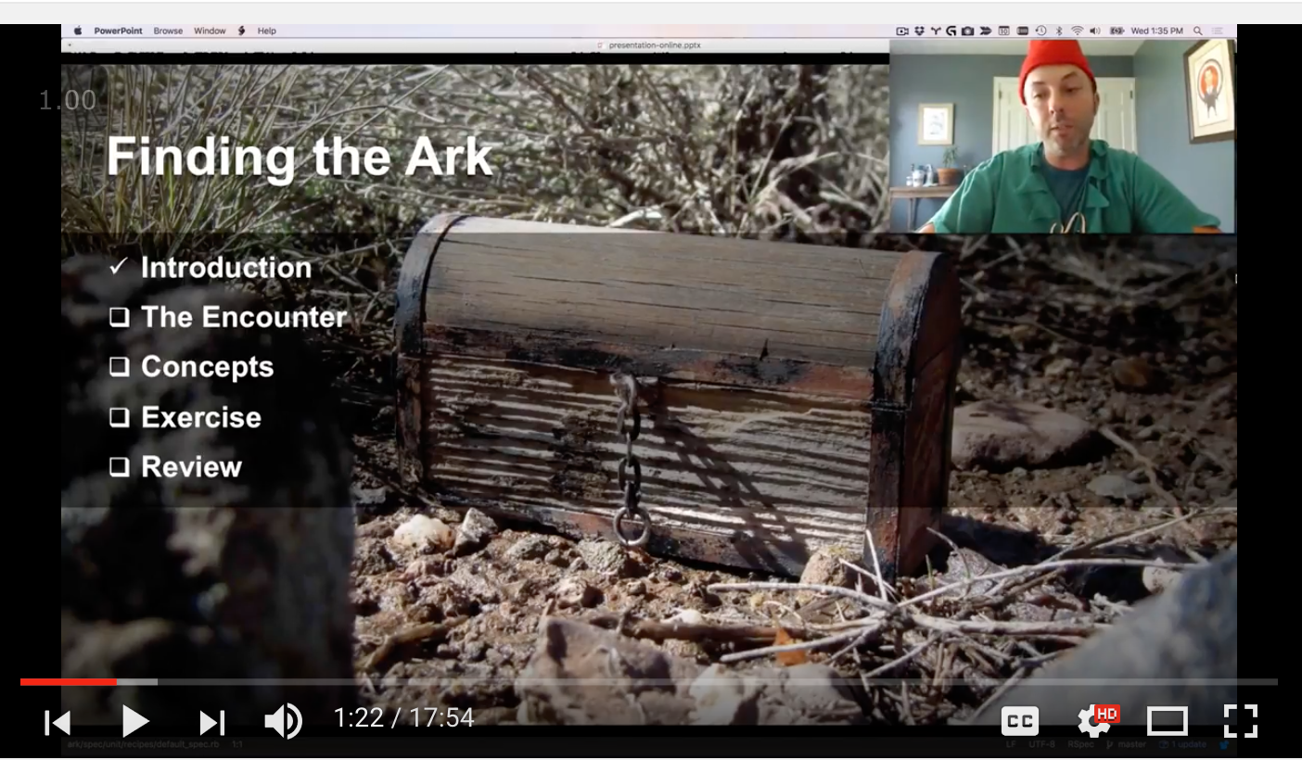
Advanced Dungeons and Testing Dragons
This adventure will test your mettle as we delve through these dark corners of cookbook development.
https://goo.gl/Qo2MfV

Slide 115
Agenda
let
shared_examples
def method
shared_context
require
alias_example_group_to
creating a Ruby gem
questions
wrap up
TECHNIQUES

Slide 116


